Slide 1
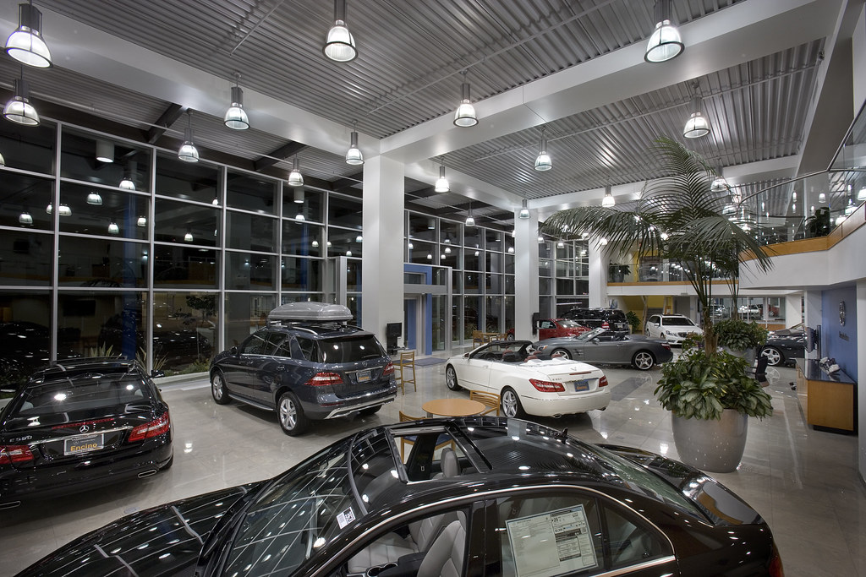
CAR PRICE PREDICTION PROJECT

Slide 2
INTRODUCTION
The price of a car depends on a lot of factors like the goodwill of the brand of the car, features of the car, horsepower and the mileage it gives and many more. Car price prediction is one of the major research areas in machine learning. With the covid 19 impact in the market, we have seen lot of changes in the car market. Now some cars are in demand hence making them costly and some are not in demand hence cheaper.

Slide 3
PROJECT TOPIC
First we need to scrap the data from the website (Olx, cardekho, Cars24 etc). Using scrape data we need to save it and work on it for finding the price of cars. We scrap the data for used cars and model prediction is done for used cars only.
There are number of feature which is used here for the prediction.
We use all the feature as per our concern while building the models.
We build types of models and then select the one model which shows its best effective capacity
We have taken care of overfitted and underfitted model. So, it can used in real time with its full capacity

Slide 4
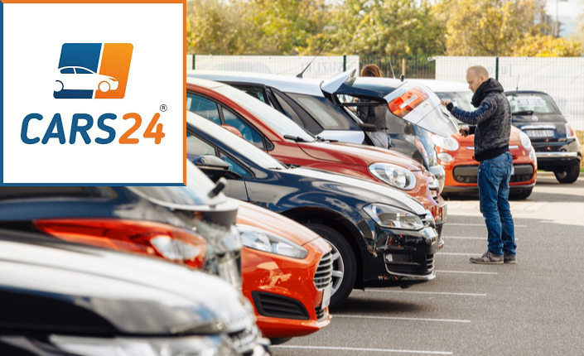
DATA SCRAPED
Data of used cars is scrapped from www.cars 24.com

Slide 5
MODELS BUILD UNDER THE PROJECT
Models build for prediction are:-
Linear Regression
Decision tree Regressor
Extra tree Regressor
Random forest Regressor
Bagging Regressor
ADA boost regressor
Gradient Boosting Regressor
Kneighbors Regressor
MLP Regressor
SVR
XGBRegressor
SGDRegressor

Slide 6
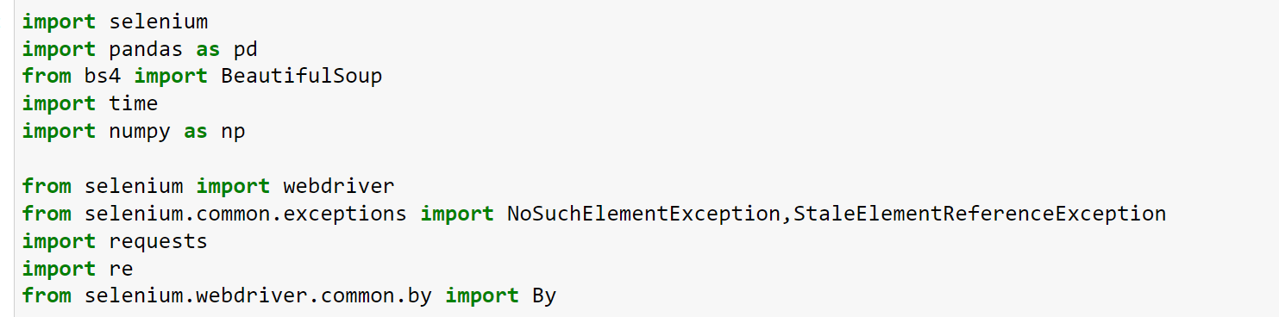
IMPORTING LIBRARIES TO SCRAP DATA
Data is scraped from cars24
Official website.
Importing some of important
Packages for scraping
Scrapping is done by the help of selenium and beautiful soup
Web driver is used to browse the website.
Common exception in selenium is used , if any error or any columns data is not available or missing it do not throw error and run again .

Slide 7
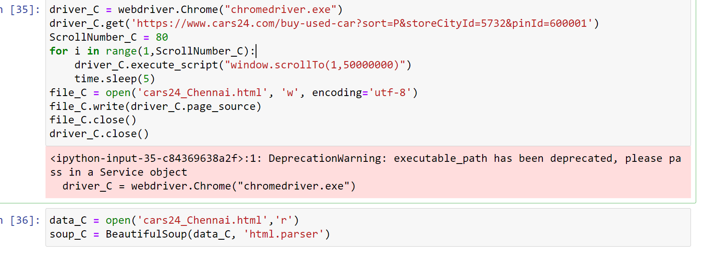
SCRAPPING DATA FROM THE WEBSITE
1.First we see that browsing the website
2.Scrolling as much as the data available
3.Opening the page source
4.Scraping the data
5.Saving the data into subsequent list

Slide 8
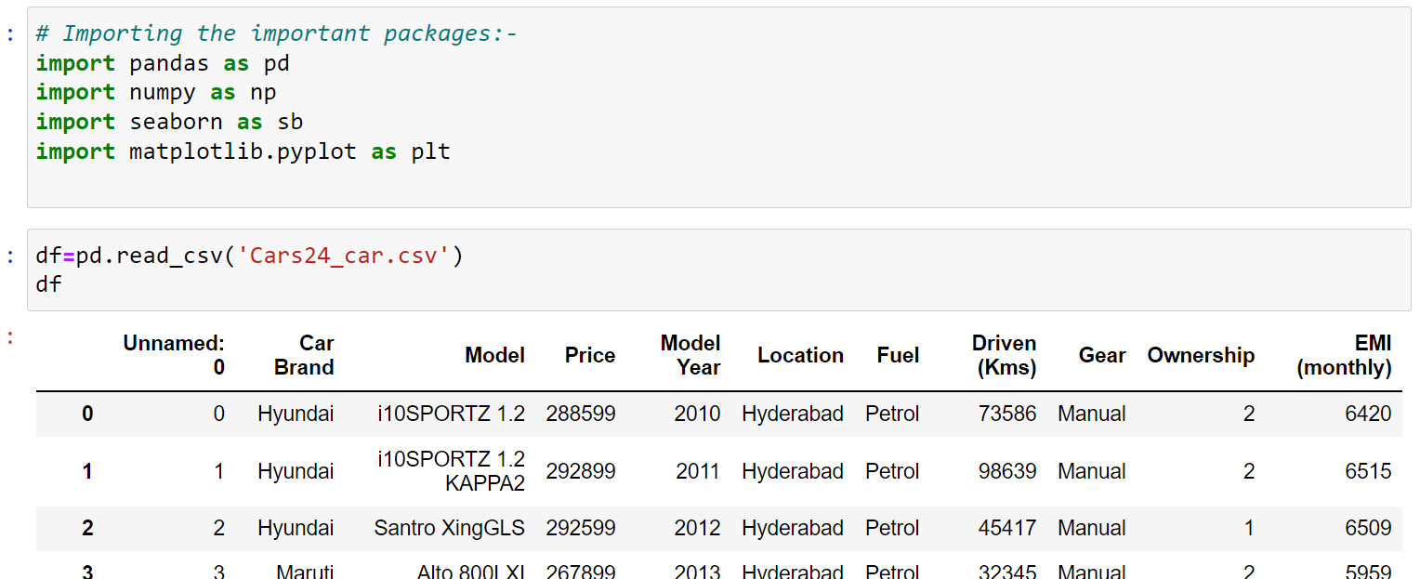
IMPORTING LIBRARIES FOR EDA AND IMPORTING SCRAPED FILE
Importing seaborn and matplotlib for
Exploratory data analysis which is used for
Graphical representation.
Importing CSV data which is scrapped
and used for further analysis and model
building

Slide 9
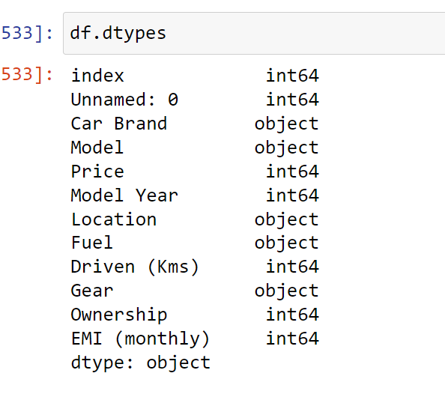
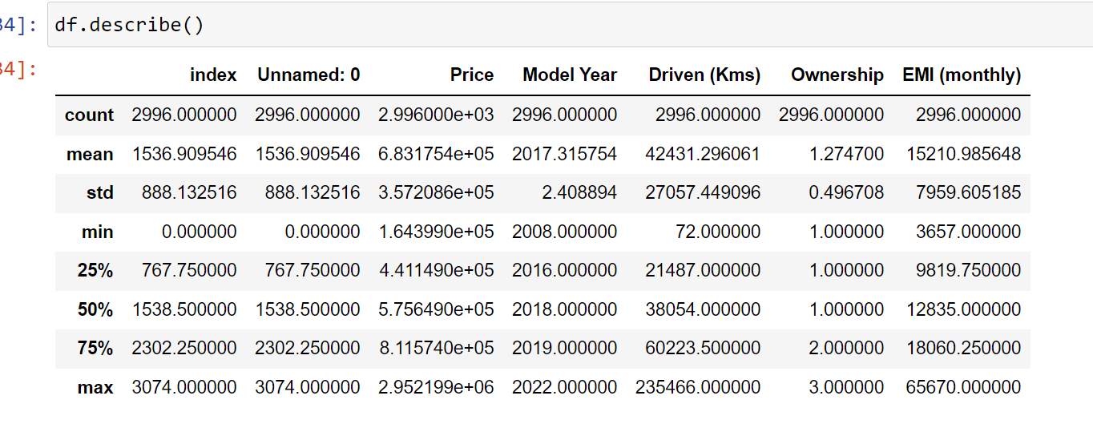
EXPLORATORY DATA ANALYSIS
The above figure shows the statistical detail
by using the describe function
It shows the columns mean, standard deviation ,quartiles
minimum value and maximum values.
Now it only showing the 5 relevant columns which is integer datatype.
Above figure shows the data type of columns
Most of them are integer and 5 of them are object or string
There are total 10 columns.

Slide 10
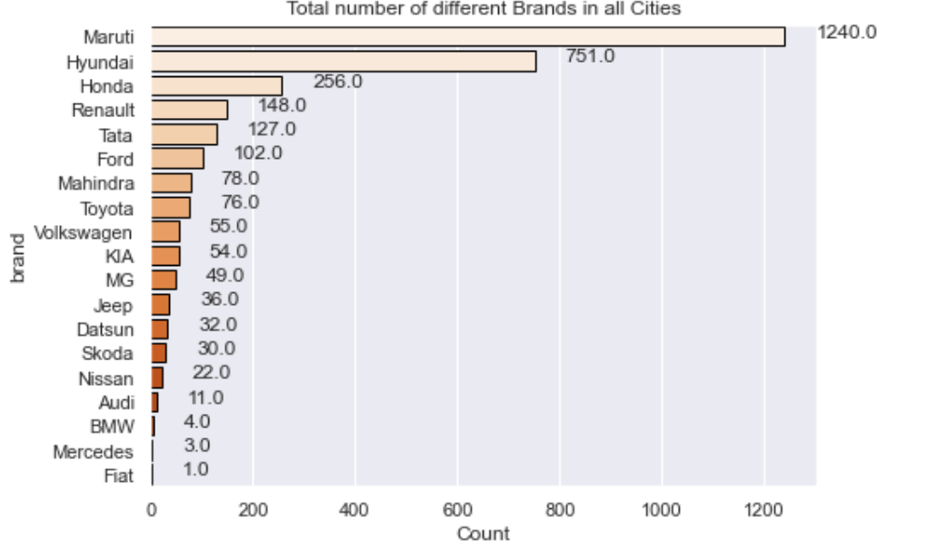
BRANDS OF CARS IN DIFFERENT CITIES
These are number of car brand
in different cities as shown in figure:-
Highest car brand is Maruti
Second is Hyundai
Third is Honda
Fiat, Mercedes, Audi and Nissan
are the least car which is purchased or we say that it is in the stock .
So, it is safe to say that Maruti ,Hyundai and Honda are first 3 choice of car.
These cars are popular in demand

Slide 11
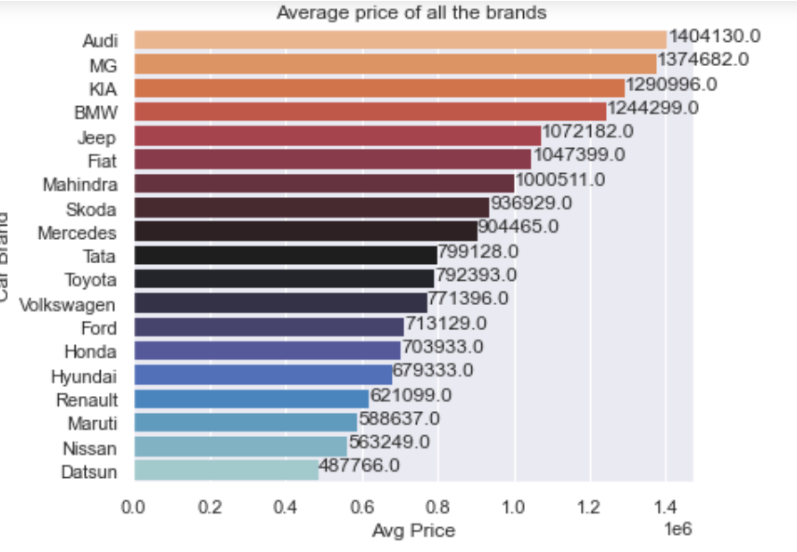
AVERAGE PRICE OF ALL CARS BRAND
Here the figure shown the Average price:-
1.As we see Audi has the highest average price .
2. Second we see MG and third is KIA.
3. Here we see clearly that average price of Maruti
Honda , Hyundai are minimum as compared to Audi
Kia ,MG and BMW
4. Nissan has low demand and average price is also low
So, it observe here Maruti ,Honda and Hyundai has high demand and comparatively low average price.

Slide 12
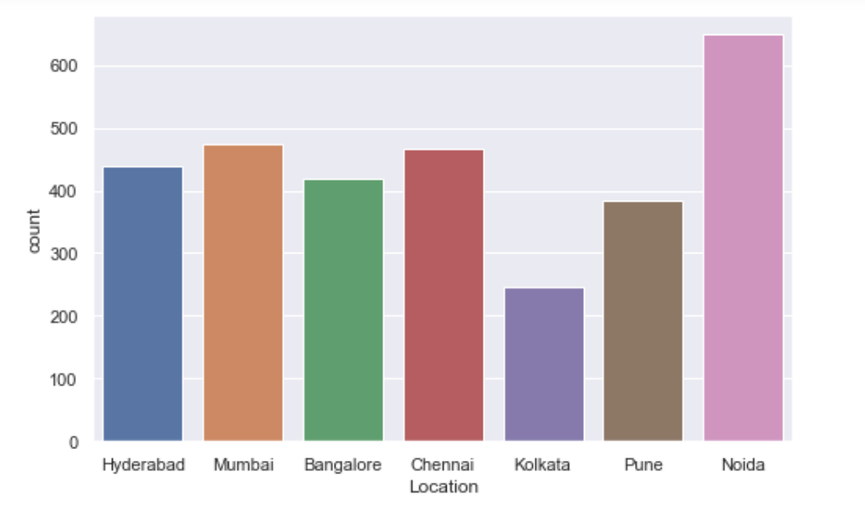
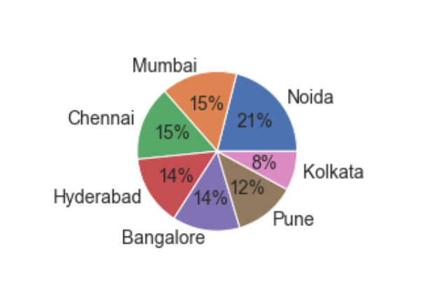
HIGHEST CARS IN LOCATION
As per observation Noida has the highest in demand of used cars.
The highest ratio is 21% of Noida and then Mumbai and Chennai
Very low ration is Kolkata among all

Slide 13
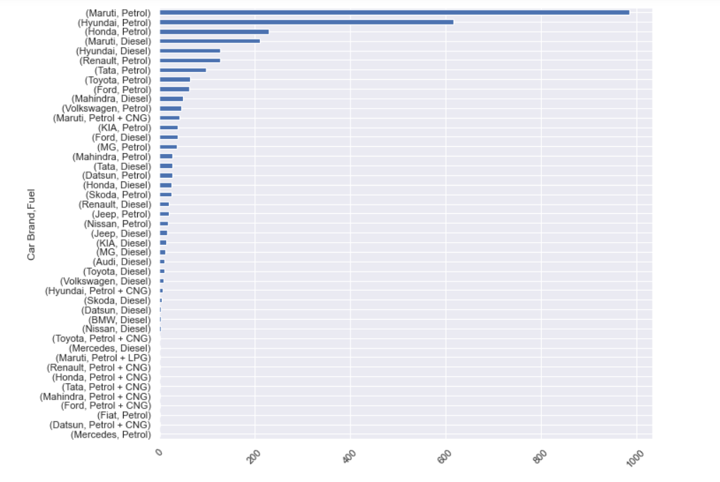
CAR BRAND AND FUEL ENGINE
The most of the car here is of Maruti with petrol engine and Hyundai with petrol and Honda with petrol
And also in deiseal car engine we see Maruti and Hyundai are good in strength. Petrol engine are
comparatively more than any other fuel engine.

Slide 14
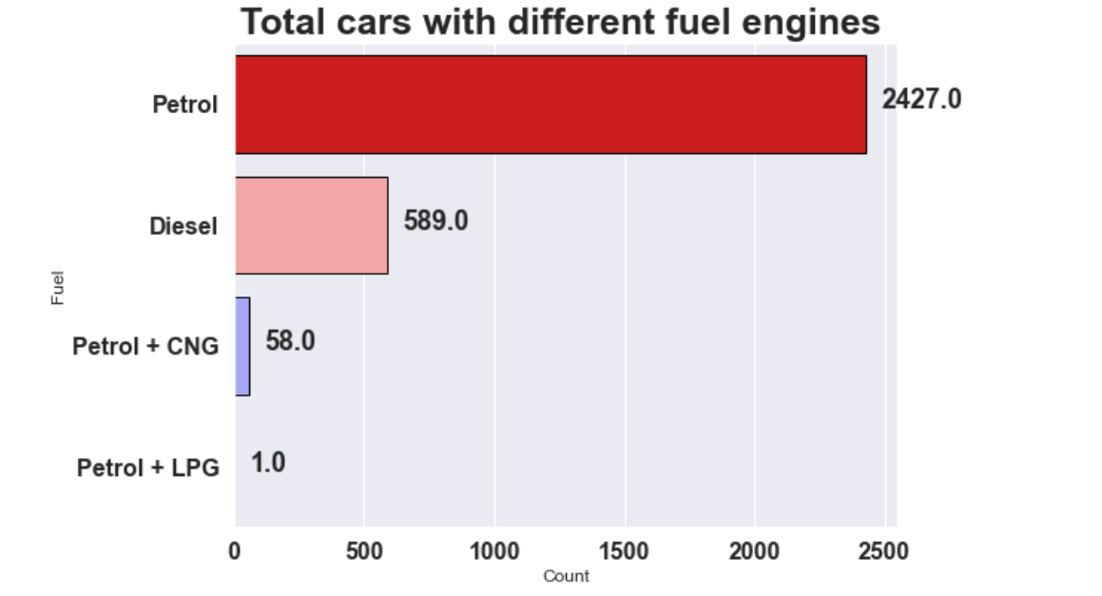
TOTAL CARS WITH FUEL ENGINES
Here, we see petrol engine cars are having 2427 which is very high than other fuel type.
Diesel has 589
Petrol+CNG has 58
Petrol+LPG has 1

Slide 15
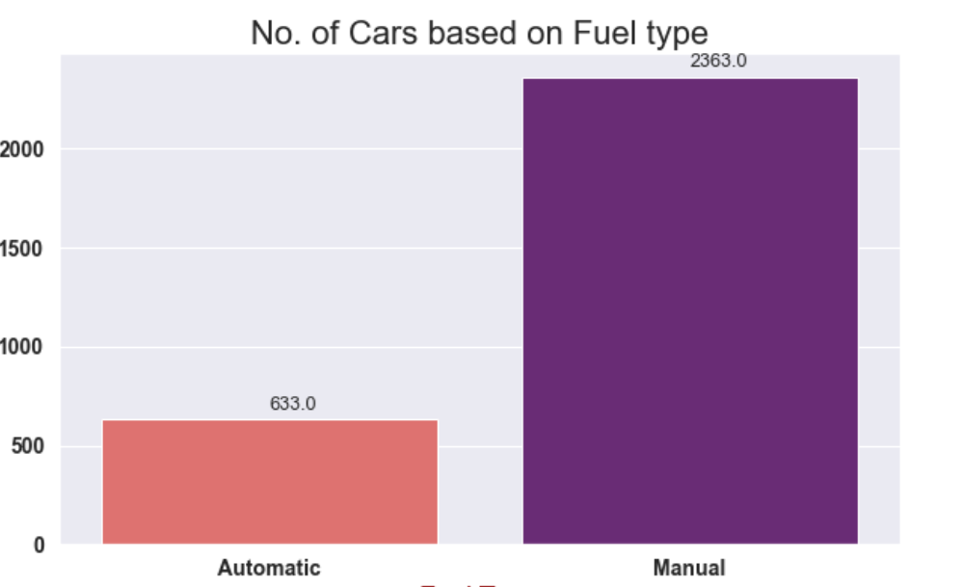
GRAPH OF CAR GEAR COUNT
MANUAL GEAR HAS HIGHEST IN DEMAND AS WE SAY IN THIS OBSERVATION

Slide 16
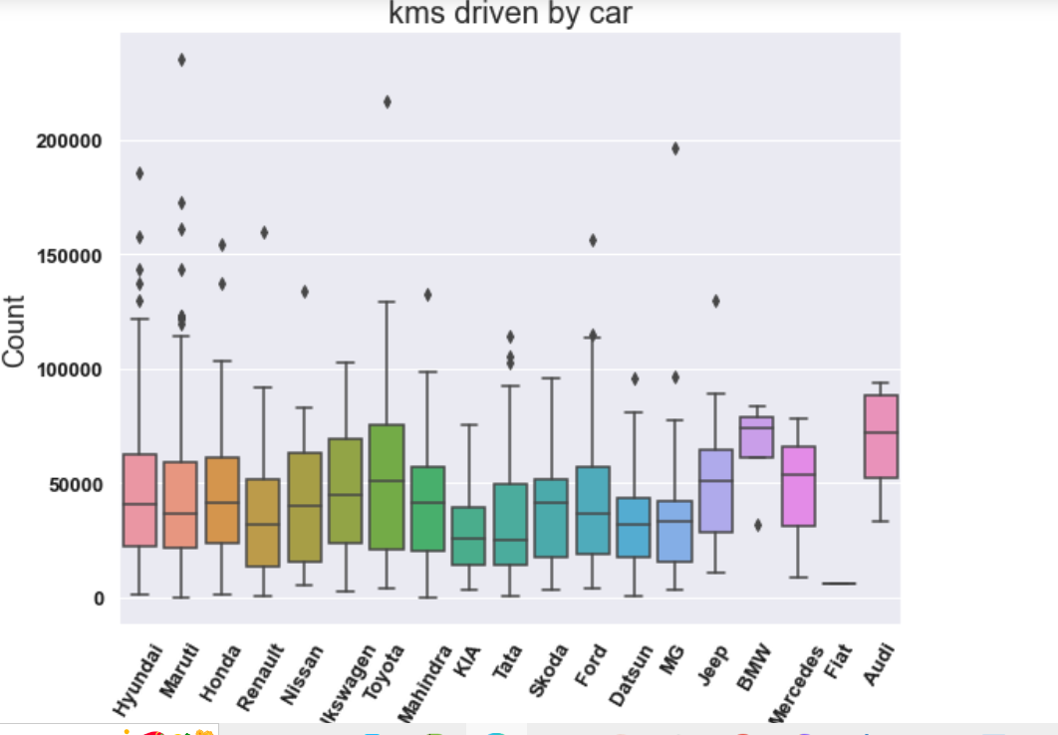
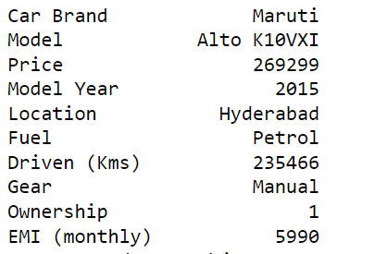
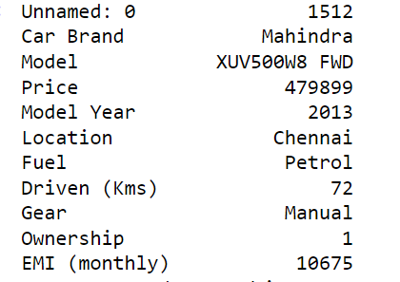
KILOMETER DRIVEN
In this graph, we observe Maruti car has highest driven cars at this time
As per graph it driven more than 235466 km which is very high.
Lowest is 72 here.

Slide 17
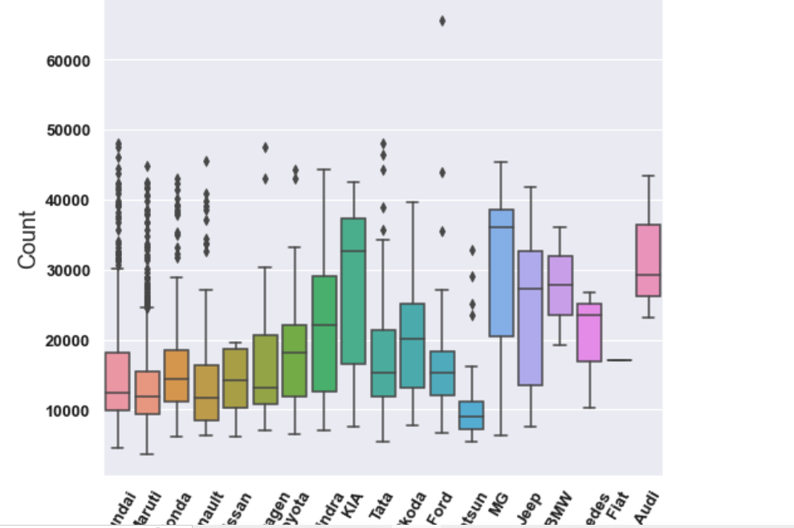
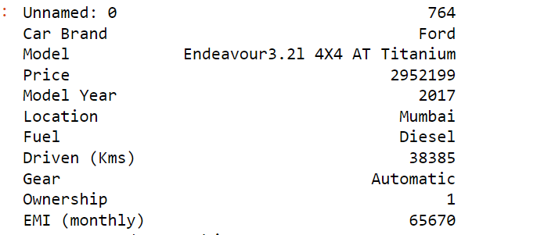
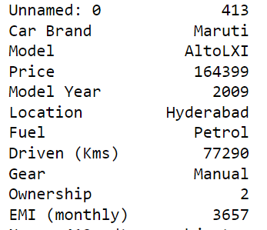
EMI OF CARS(monthly)
The highest EMI we see as per brand is Ford and low EMI is
available Maruti.
There is vast difference between high and low EMI
highest=65670, lowest=3675.

Slide 18
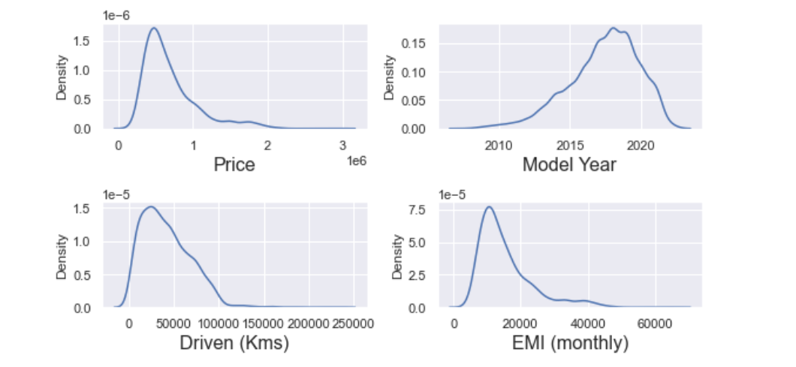
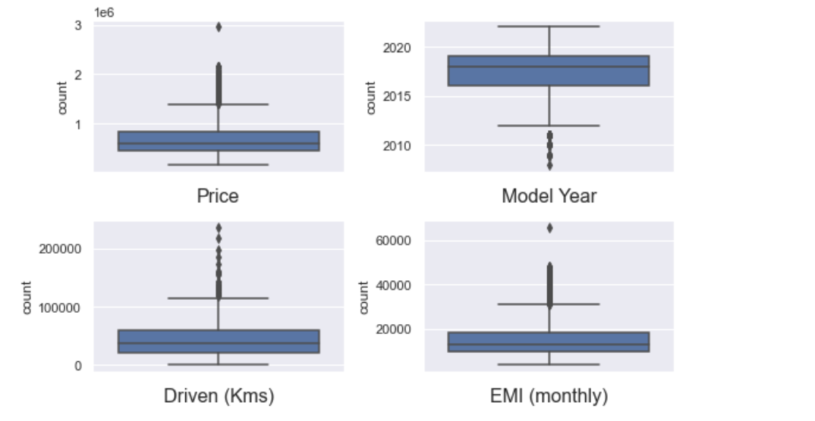
SKEWNESS AND OUTLIERS GRAPH
These are the graph of numerical feature , this feature has skewness and another graph shows outliers.
These shows data is ambiguous and so, we have to remove the skewness and outliers and bring data in one scale so it can predict and that prediction should be unbiased

Slide 19
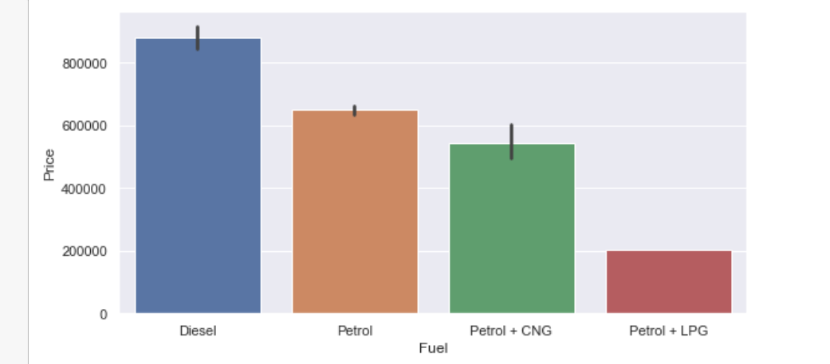
PRICE AND FUEL RELATION
As per observation of graph the
price of diesel fuel engine is highest
and petrol engine is second in graph.
Petrol fuel engine is high but
comparatively low from Diesel.
We see different of petrol and petrol +CNG is not So much , as they have the difference but not so vast

Slide 20
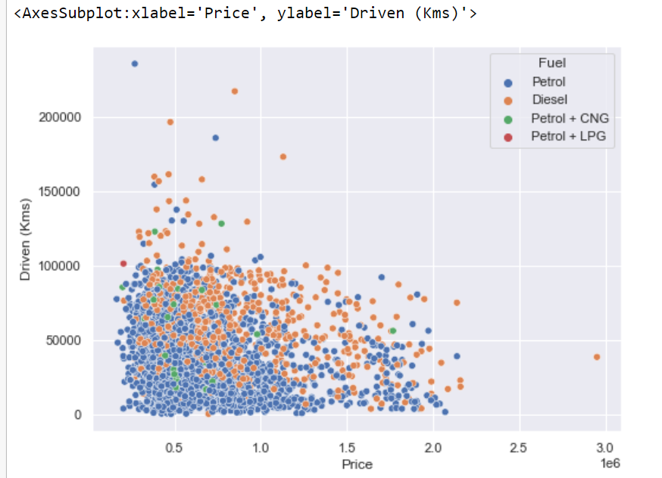
PRICE AND KILOMETER DRIVEN BY CARS
As we see the graph there is not any kind of relation seen here with this Price and KMS driven
It can easy to say that this feature is not so much related with target variable.
It may contribute but not so correlated

Slide 21
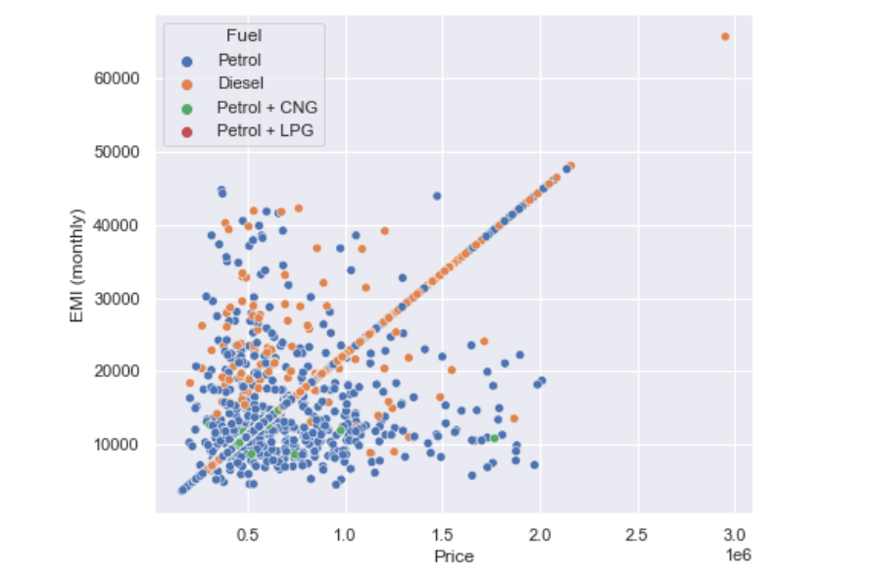
PRICE AND EMI RELATION
Yes, it shows the upward trend with target variable (price)
It is positively related .

Slide 22
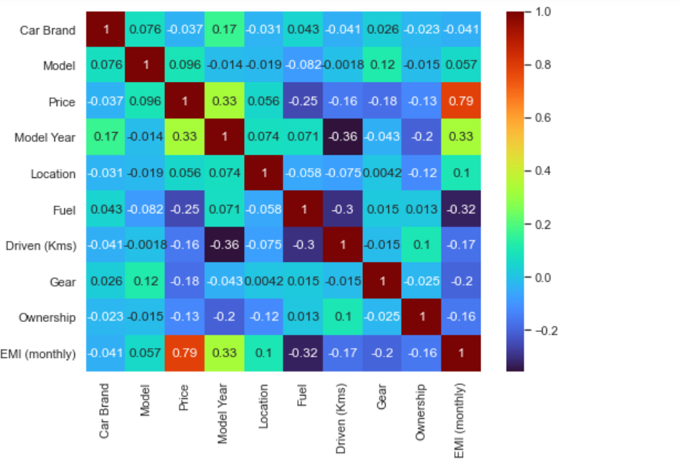
CORRLEATION GRAPH
The correlation graph indicate:-
1.Highest correlation is between
EMI and price(Target variable)
which is 0.79
2.Second most strong correlation
to target is model year 0.33
3. Some of feature are negatively or
very low correlated.
4. Two features show some of
multicollinearity i.e. driven kms
and ownership
Although it shows very little contribution of Ownership and Driven kms, it contribute very less so we need not
to worry about the multicollinearity.

Slide 23
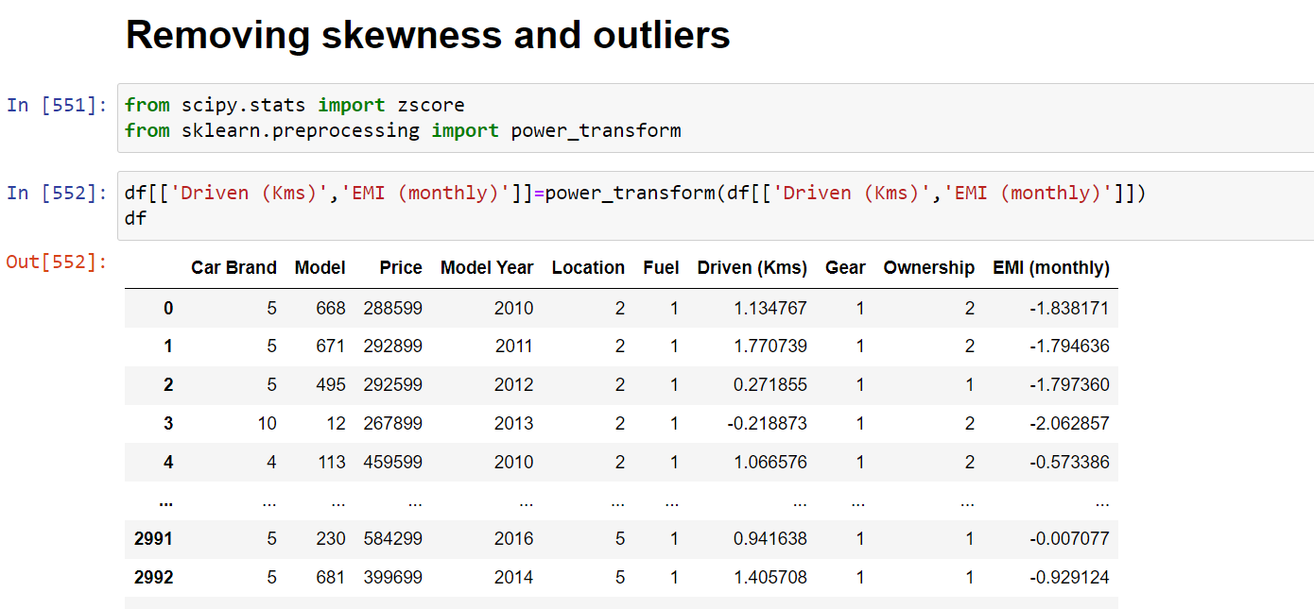
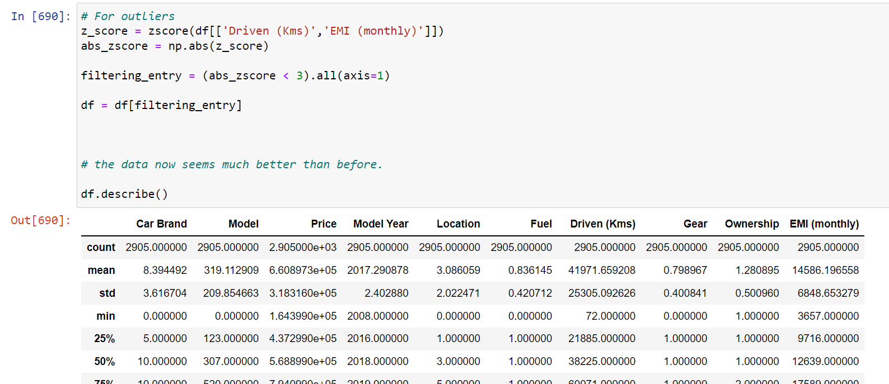
REMOVING SKEWNESS AND OUTLIERS
Removing skewness :- using here power transformer
Removing outliers:- Using here
z - score

Slide 24
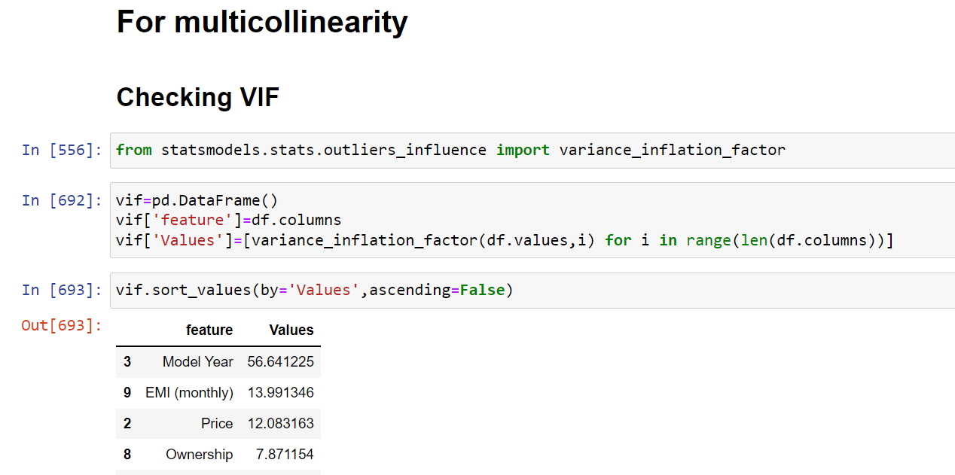
CHECKING MULTICOLLINERITY
Checking multicollinearity by using
Variance inflation factor
Data is good no multicollinearity problem.
good to proceed.

Slide 25
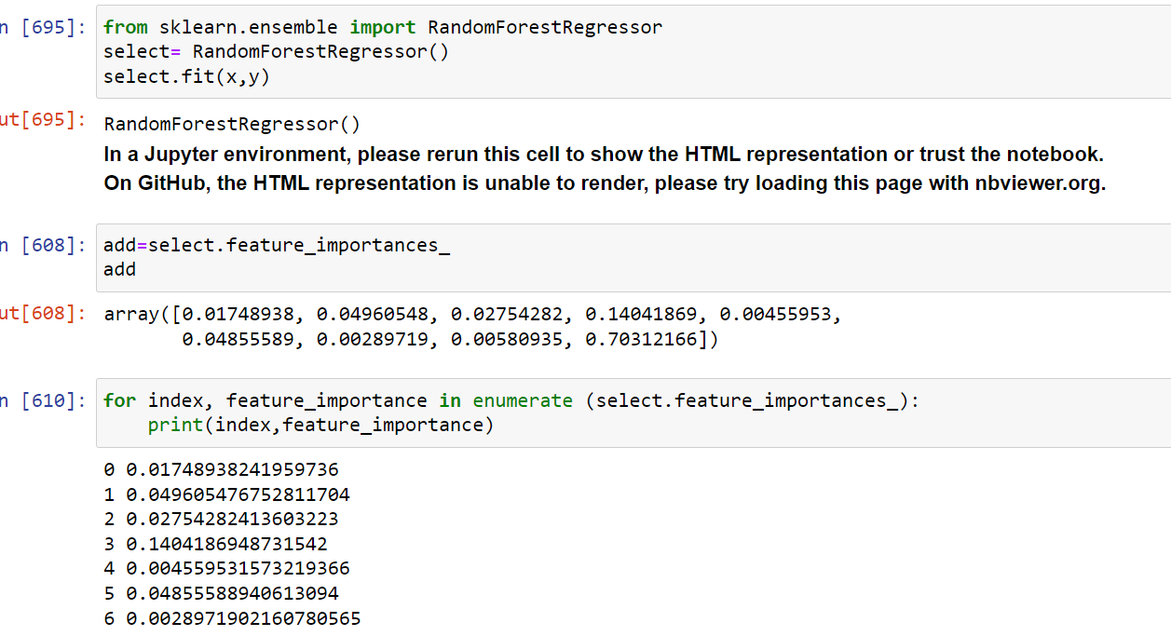
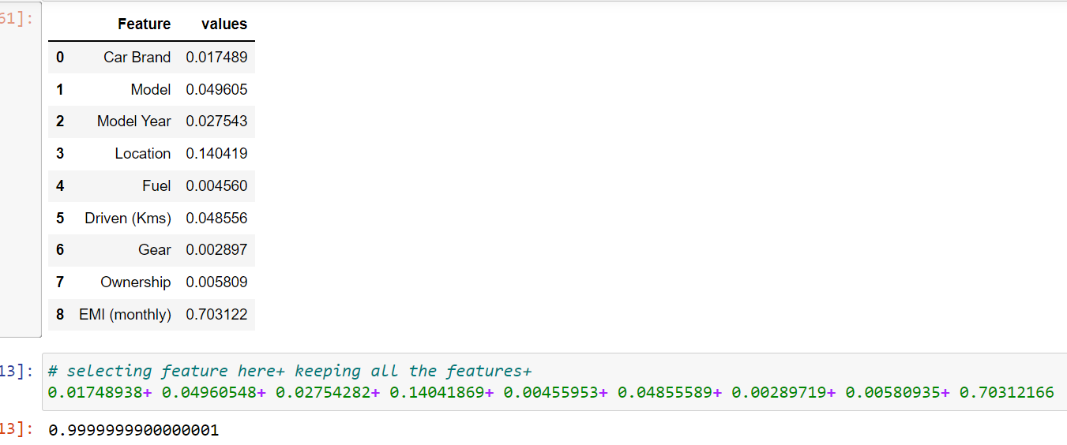
FEATURE SELECTION
Feature selection is used for select
the features for prediction
Here as we see random forest is used for
feature selection
Here added all the feature value and see
it shows 0.9999
It is clear that we do not drop any columns here
We select all the columns

Slide 26
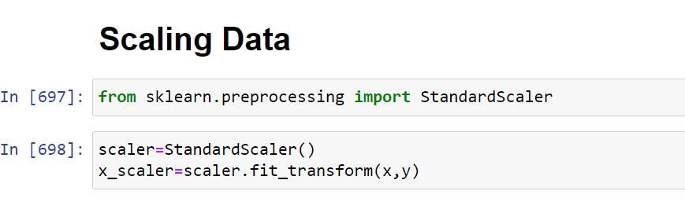
SCALING DATA
Scaling data is done here, to bring all the feature at single scale, because all the feature has different magnitude, for prediction feature do not show any biased behaviour so, we scale the data

Slide 27
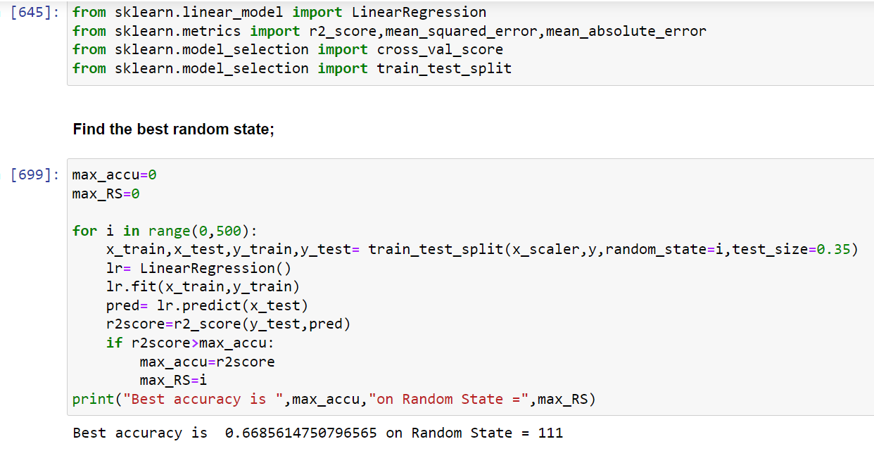
TRAINING MODEL
Here we use some of matrix and linear regression for finding best random state

Slide 28
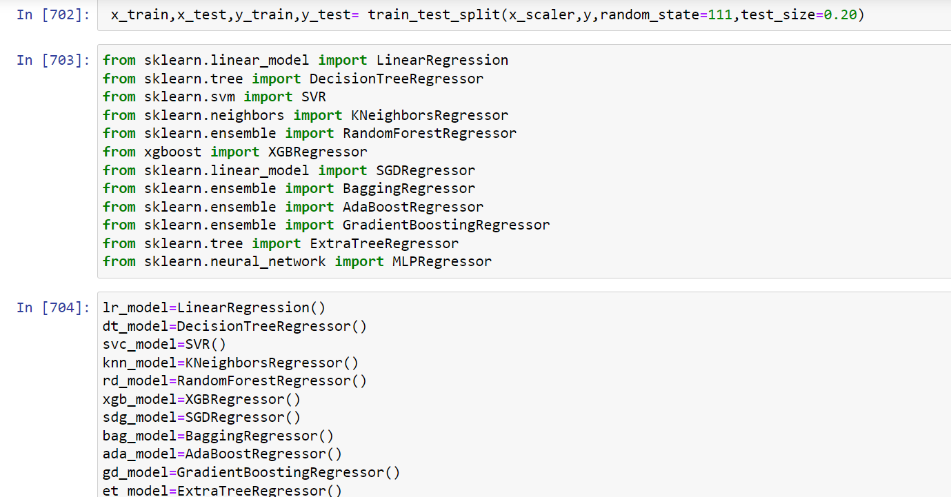
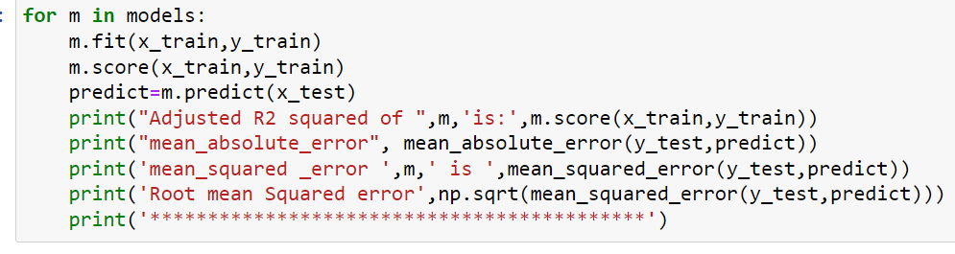
MODELS USED FOR PREDICTION

Slide 29
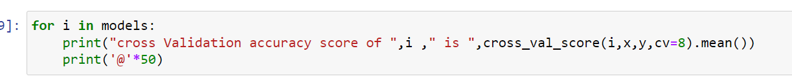
CROSS VALIDATION
Cross validation is used to prevent model from overfitting when used in real time.
It do not fail when used in real time

Slide 30
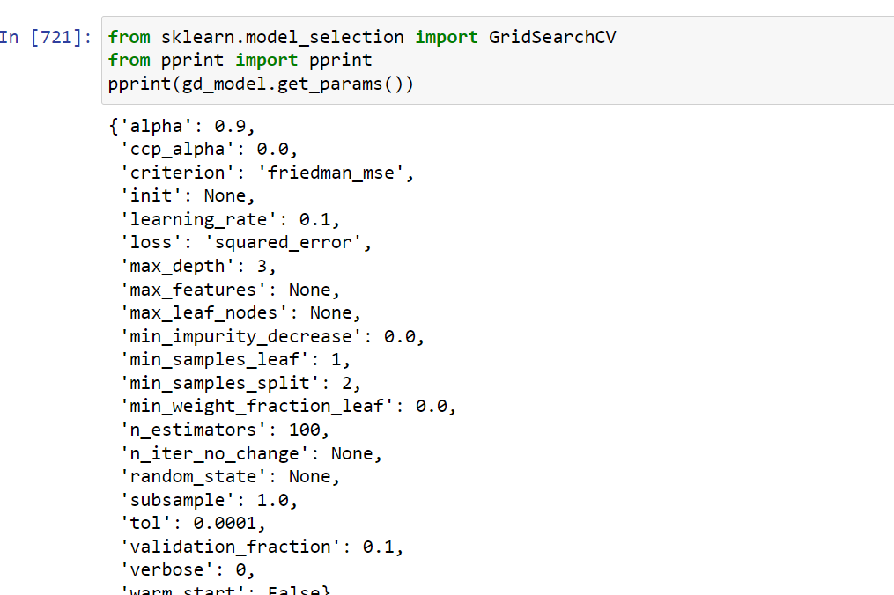
HYPERPARAMETER TUNING
Grid search is used for hyper parameter tuning to tune the model to make it work to its best capacity

Slide 31
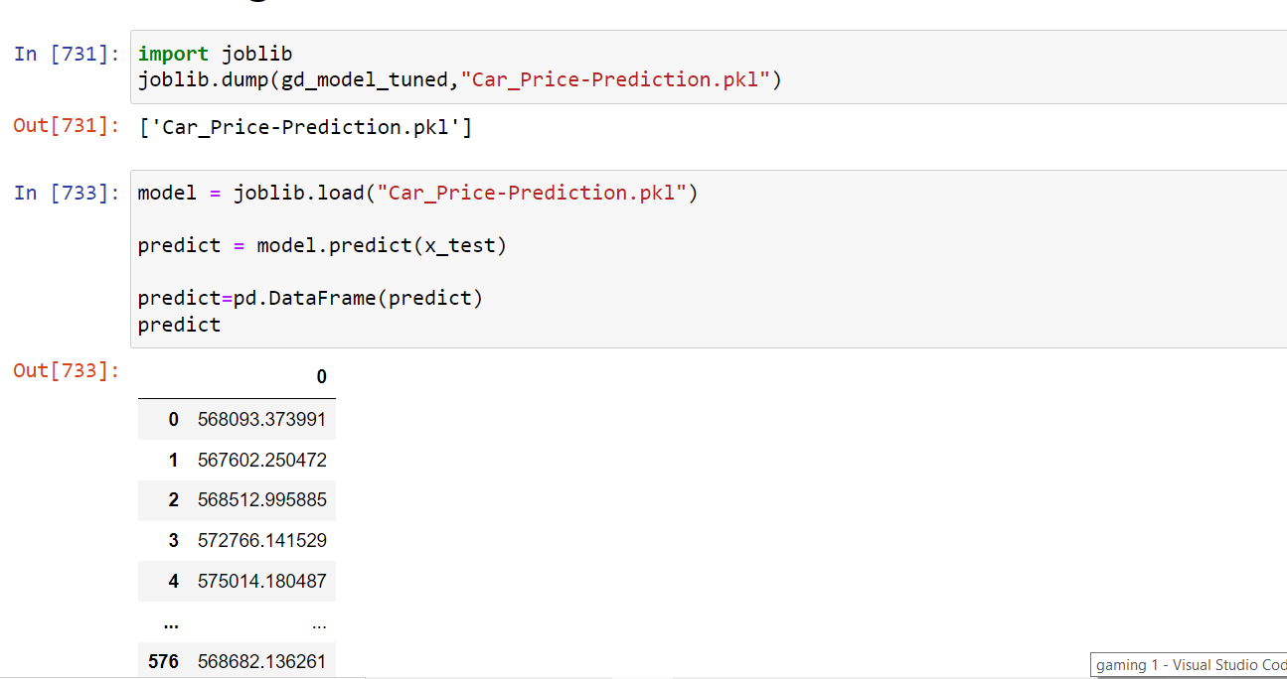
TEST ITS PREDICTION AND SAVE THE MODEL

Slide 32
CONCLUSION
The increased prices of new cars and the financial incapability of the customers to buy them, Used Car sales are on a global increase. Therefore, there is an urgent need for a Used Car Price
Prediction system which effectively determines the worthiness of the car using a variety of features. The proposed system will help to determine the accurate price of used car price prediction. This paper compares different algorithms for machine learning.
Future Analysis : In future this machine learning model may bind with various website which can provide real time data for price prediction. Also we may add large historical data of car price which can help to improve accuracy of the machine learning model. We can build an android app as user interface for interacting with user. For better performance, we plan to
judiciously design deep learning network structures, use adaptive learning rates and train on clusters of data rather than the whole dataset and can filter or add data as per the costumer’s
requirements. India will be the biggest market for the used cars, used car market in India has been the center of attention in the slow growing automotive industry in India.

Slide 33

Thank you

